Slide 1
RFID Door Lock System
Photo by Charles Forerunner on Unsplash
Notes:
© Copyright Showeet.com – Creative & Free PowerPoint Templates

Slide 2
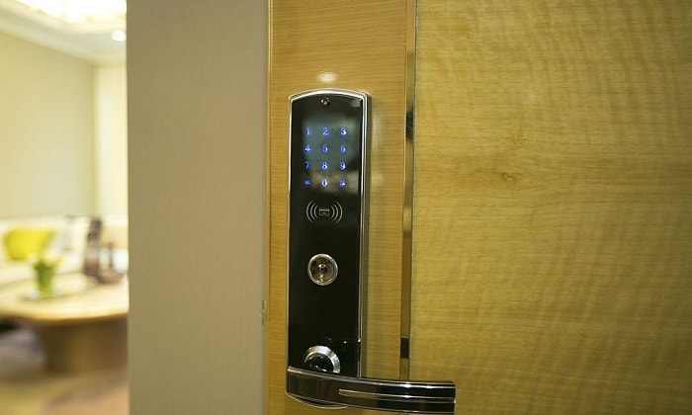
RC 522 Module
Arduino Uno
Servo Motor
Buzzer
Led’s
RFID Cards/Tags
Notes:
© Copyright Showeet.com – Creative & Free PowerPoint Templates

Slide 3
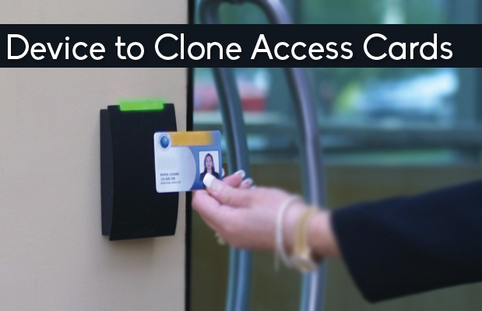
RFID Card Cloning
Photo by Rizky Subagja on Unsplash
Notes:
© Copyright Showeet.com – Creative & Free PowerPoint Templates

Slide 4
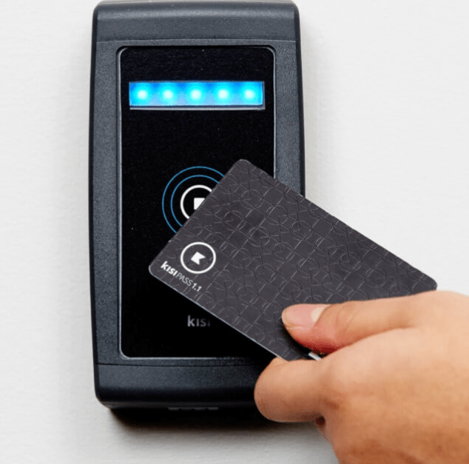
RC 522 Module
Arduino Uno
RFID cards/Tags
Notes:
© Copyright Showeet.com – Creative & Free PowerPoint Templates

